Slide 1
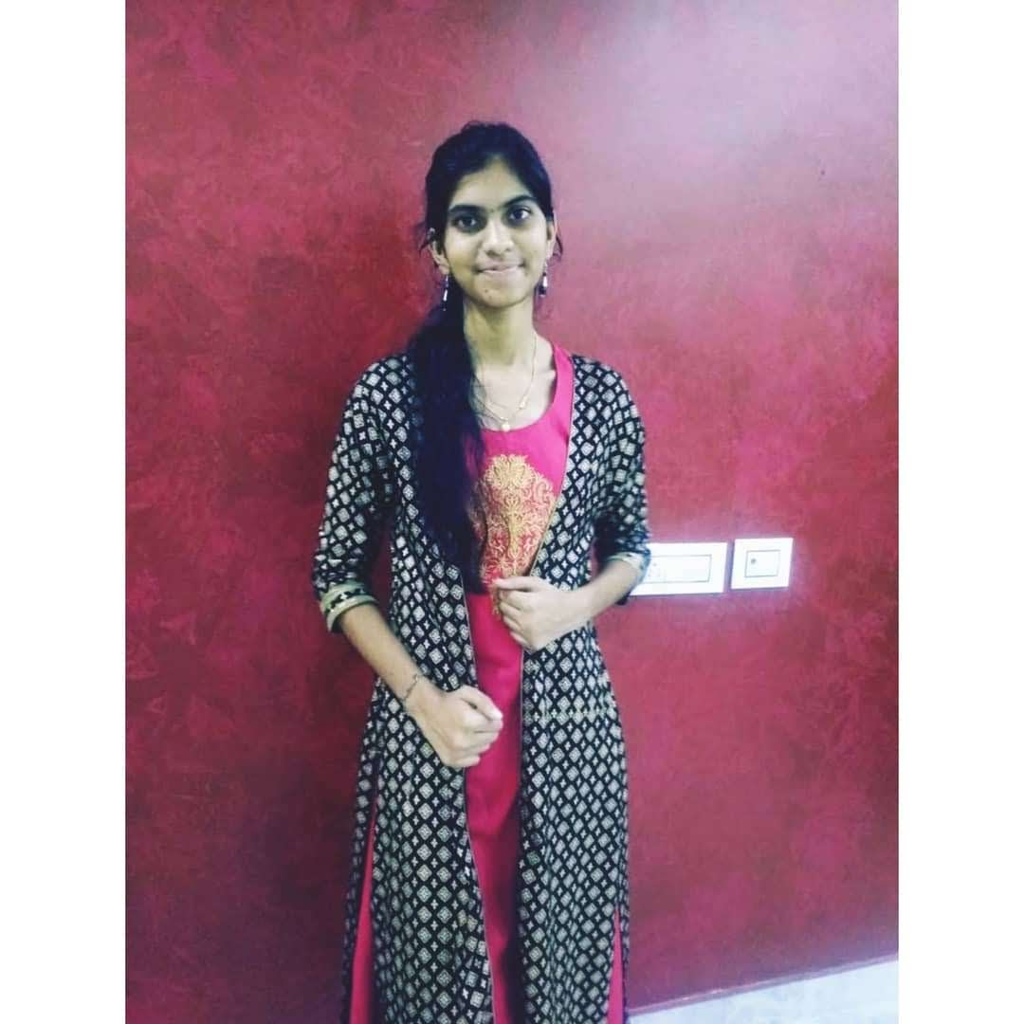


POOJITHA SUDI
Analyst/Software Engineer
Bachelor of Technology
Computer Science and Engineering : 2017 - 2021
Skills Java 8
Spring Boot
Spring Core
Backend
Spring Boot
Spring Core
Rest API
Node Js
Database
SQL database
PostgreSQL
Web Technologies
HTML5
CSS3
Javascript,ES6
Bootstrap
AddOns
Github
Gradle
Swagger,Eclipse
Additional Details
Leadership
Proficient Communication
Team management
Mumbai
poojitha.sudi@capgemini.com
8184835672
A4
Software Engineer who is Strong in design and integration with intuitive problem-solving skills. Passionate about implementing and launching new projects.
Ready to learn new technologies and implement them to further improve of my knowledge.
Eager to work in a team of dedicated people and serve a key role in the enhancement and development of the project.
Has working knowledge on React and Java Development using Spring framework on an intermediate level.
https://github.com/POSUDI/POSUDI
e-Vehicle-Rental System(User Info and Admin)
Created a Booking Application(vehicle) with spring boot as backend along with swagger for testing .
React as frontend, used HTML5 ,CSS ,ES6 and bootstrap for designing responsive web pages .

